Slide 1
UC Berkeley’s CS61A – Lecture 05 – Environments
CS+X fails at Stanford www.stanforddaily.com/2019/01/23/csx-major-program-to-no-longer-accept-new-students
“Just four years after its inception, the CS+X joint major pilot program will be “discontinued” due to limited interest. The academic program allows students to attain a Bachelor’s of Arts and Sciences degree in CS and a humanities discipline. Since its launch as a six-year pilot program in fall 2014, the CS+X has expanded from two joint majors, CS+English and CS+Music, to 14 majors combining computer science with various humanities disciplines. However, the program conferred fewer than 15 degrees in the 2017-2018 academic year and has drawn criticism for its lack of depth and interdisciplinary cohesion. Prof Eric Roberts also intended for the CS+X program to reduce the load on computer science professors. But according to him, “faculty across the university saw the CS+X idea as a way to integrate more computer science into their own majors.” Roberts believes this put additional strain on an already-overwhelmed CS department. While 20 percent of undergraduates major in computer science, only two percent of the University’s faculty teach in the department. He observed that overload in the CS department has contributed to increased attrition among faculty.”

Slide 2
Announcements

Slide 3
Environments for Higher-Order Functions

Slide 4
Environments Enable Higher-Order Functions
Functions are first-class: Functions are values in our programming language
Higher-order function: A function that takes a function as an argument value or A function that returns a function as a return value
Environment diagrams describe how higher-order functions work!
(Demo1)

Slide 5
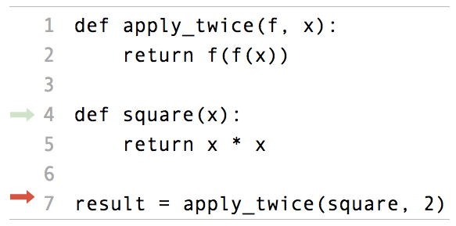
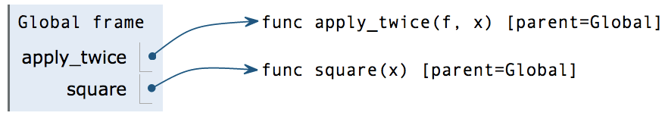
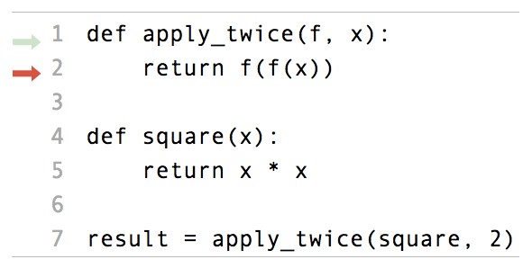
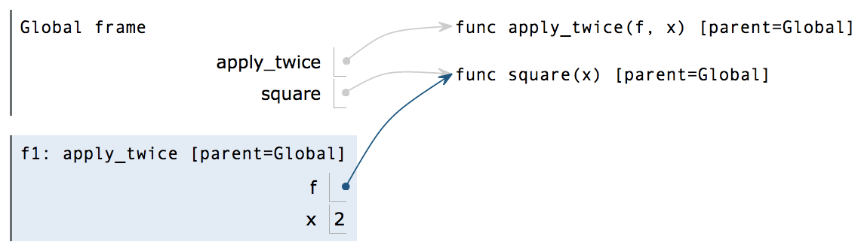
Names can be Bound to Functional Arguments
Applying a user-defined function:
Create a new frame
Bind formal parameters (f & x) to arguments
Execute the body: return f(f(x))
2
1
pythontutor.com/composingprograms.html#code=def%20apply_twice%28f,%20x%29%3A%0A%20%20%20%20return%20f%28f%28x%29%29%0A%20%20%20%20%0Adef%20square%28x%29%3A%0A%20%20%20%20return%20x%20*%20x%0A%20%20%20%20%0Aresult%20%3D%20apply_twice%28square,%202%29&mode=display&origin=composingprograms.js&cumulative=true&py=3&rawInputLstJSON=[]&curInstr=0

Slide 6
Functions as Return Values

Slide 7
Locally Defined Functions
Functions defined within other function bodies are bound to names in a local frame
A function that returns a function
The name add_three is bound to a function
A def statement within another def statement
Can refer to names in the enclosing function

Slide 8
Call Expressions as Operator Expressions
An expression that evaluates to a function
An expression that evaluates to its argument
Operator
Operand
3
make_adder(1) ( 2 )
func adder(k)
2
make_adder(1)
func make_adder(n)
1
make_adder( n ):
func adder(k)

Slide 9
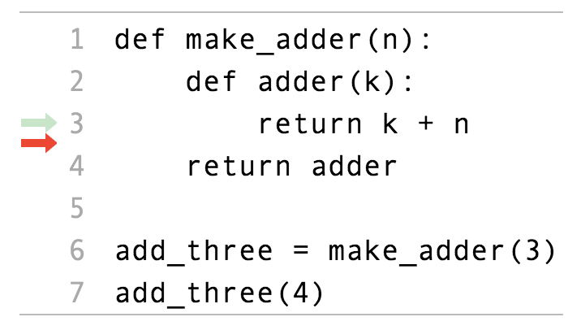
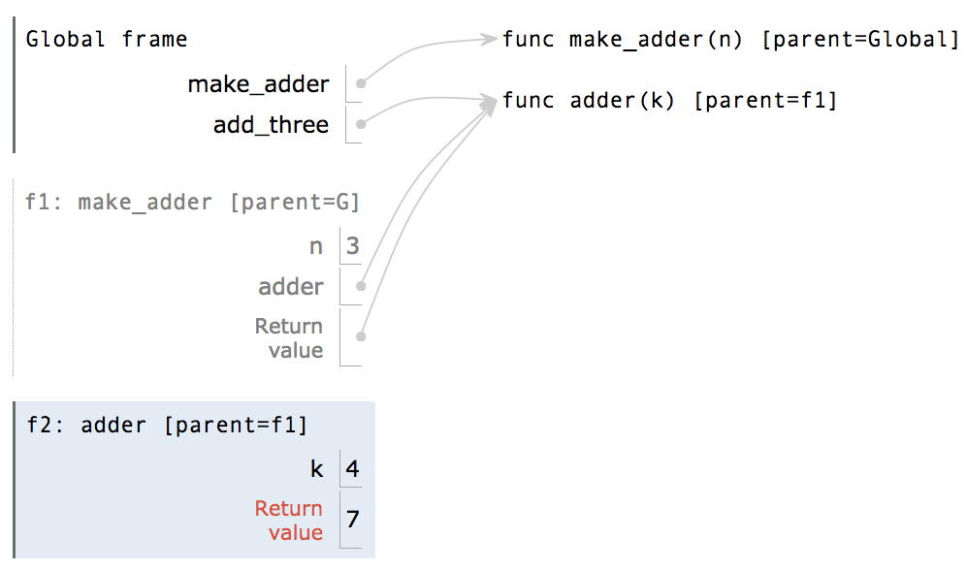
Environment Diagrams for Nested Def Statements
Nested def
3
2
Every user-defined function has a parent frame (often global)
The parent of a function is the frame in which it was defined
Every local frame has a parent frame (often global)
The parent of a frame is the parent of the function called
1
http://pythontutor.com/composingprograms.html#code=def%20make_adder%28n%29%3A%0A%20%20%20%20def%20adder%28k%29%3A%0A%20%20%20%20%20%20%20%20return%20k%20%2B%20n%0A%20%20%20%20return%20adder%0A%20%20%20%20%0Athree_more_than%20%3D%20make_adder%283%29%0Aresult%20%3D%20three_more_than%284%29&cumulative=false&curInstr=0&mode=display&origin=composingprograms.js&py=3&rawInputLstJSON=%5B%5D

Slide 10
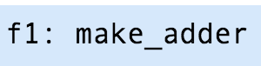
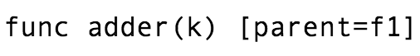
How to Draw an Environment Diagram
When a function is defined:
Create a function value: func <name>(<formal parameters>) [parent=<label>]
Its parent is the current frame.
Bind <name> to the function value in the current frame
When a function is called:
Add a local frame, titled with the <name> of the function being called.
Copy the parent of the function to the local frame: [parent=<label>]
Bind the <formal parameters> to the arguments in the local frame.
Execute the body of the function in the environment that starts with the local frame.

Slide 11
Local Names
(Demo2)

Slide 12
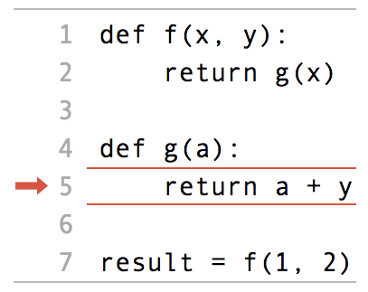
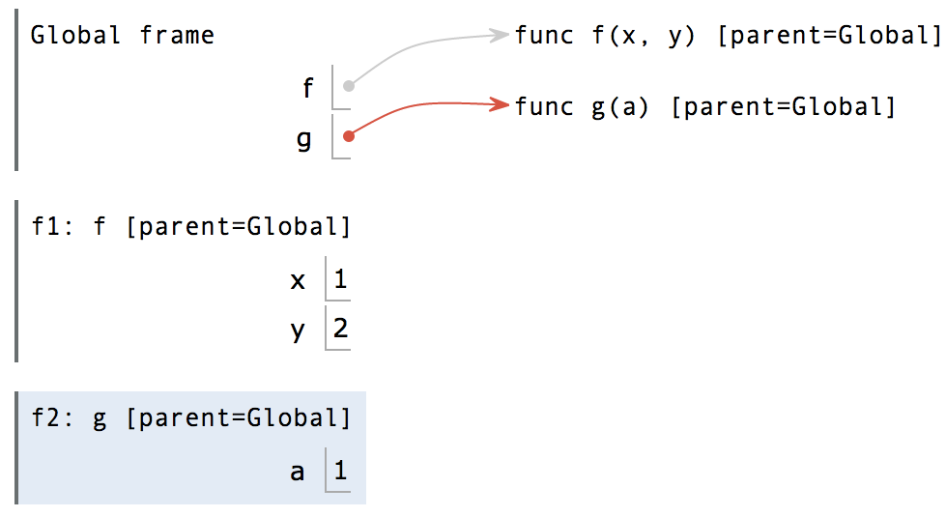
Local Names are not Visible to Other (Non-Nested) Functions
“y” is not found, again
Error
2
“y” is not found
1
An environment is a sequence of frames.
The environment created by calling a top-level function (no def within def) consists of one local frame, followed by the global frame.
http://pythontutor.com/composingprograms.html#code=def%20f%28x,%20y%29%3A%0A%20%20%20%20return%20g%28x%29%0A%0Adef%20g%28a%29%3A%0A%20%20%20%20return%20a%20%2B%20y%0A%20%20%20%20%0Aresult%20%3D%20f%281,%202%29&cumulative=true&curInstr=0&mode=display&origin=composingprograms.js&py=3&rawInputLstJSON=%5B%5D

Slide 13
Lambda Expressions
λ
(Demo4)

Slide 14
Lambda Expressions
An expression: this one evaluates to a number
>>> x = 10
>>> square = x * x
Also an expression: evaluates to a function
>>> square = lambda x: x * x
Important: No "return" keyword!
A function
with formal parameter x
that returns the value of "x * x"
>>> square(4)
16
Must be a single expression
Lambda expressions are not common in Python, but important in general
Lambda expressions in Python cannot contain statements at all!

Slide 15


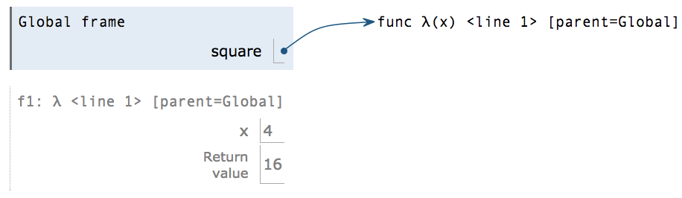
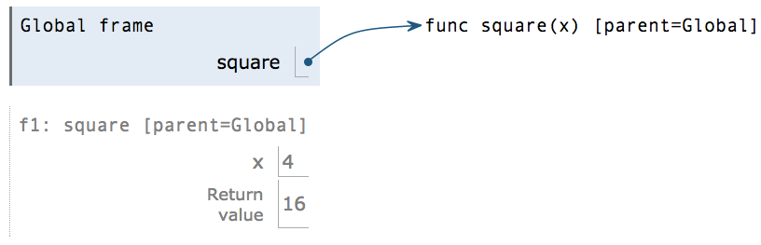
Lambda Expressions Versus Def Statements
square = lambda x: x * x
VS
def square(x):
return x * x
Both create a function with the same domain, range, and behavior.
Both bind that function to the name square.
Only the def statement gives the function an intrinsic name, which shows up in environment diagrams but doesn't affect execution (unless the function is printed).
The Greek letter lambda

Slide 16
Function Composition
(Demo5)

Slide 17
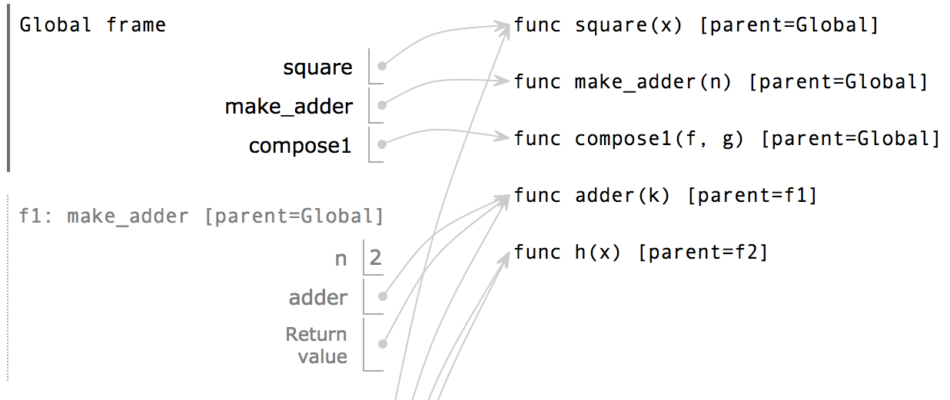
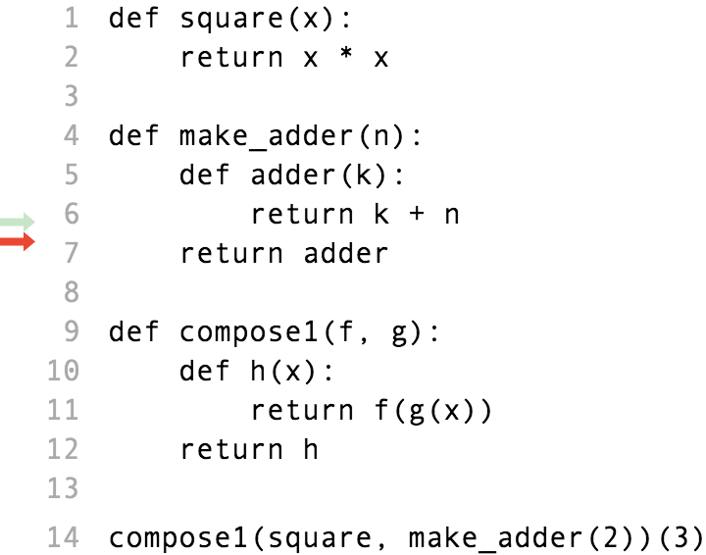
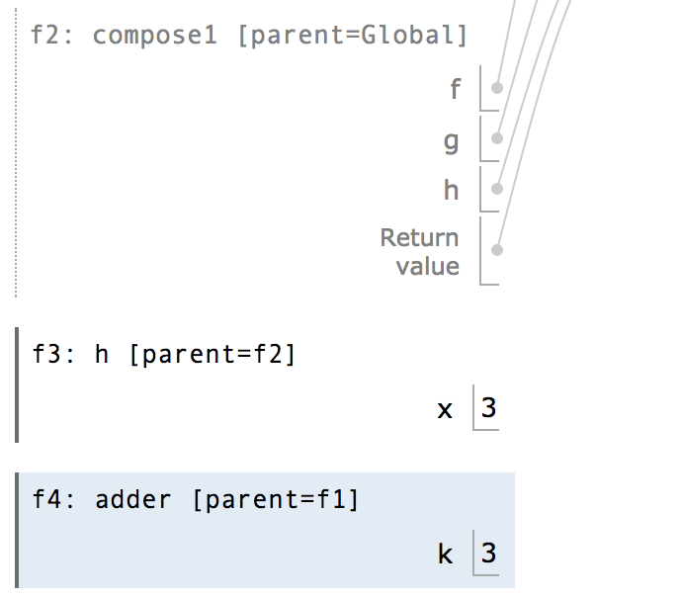
The Environment Diagram for Function Composition
3
3
2
2
Return value of make_adder is an argument to compose1
1
1
http://pythontutor.com/composingprograms.html#code=def%20square%28x%29%3A%0A%20%20%20%20return%20x%20*%20x%0A%0Adef%20make_adder%28n%29%3A%0A%20%20%20%20def%20adder%28k%29%3A%0A%20%20%20%20%20%20%20%20return%20k%20%2B%20n%0A%20%20%20%20return%20adder%0A%20%20%20%20%0Adef%20compose1%28f,%20g%29%3A%0A%20%20%20%20def%20h%28x%29%3A%0A%20%20%20%20%20%20%20%20return%20f%28g%28x%29%29%0A%20%20%20%20return%20h%0A%20%20%20%20%0Acompose1%28square,%20make_adder%282%29%29%283%29&cumulative=true&curInstr=0&mode=display&origin=composingprograms.js&py=3&rawInputLstJSON=%5B%5D

